Slide 1
STATUS CODES
By
Nikhila Ravipudi
Shyam Prasad reddy Bachu
Naga Sindhu Pullela
Supreetham B V S

Slide 2

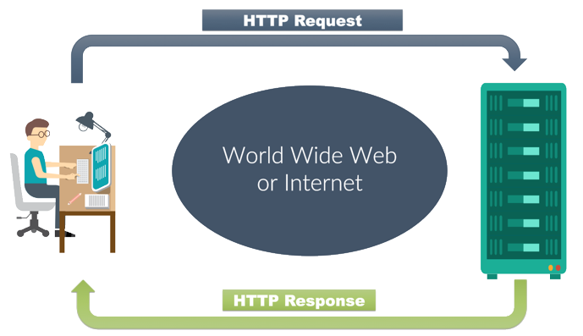
What is Status code?
When a search engine or website visitor makes a request to a web server, a three digit HTTP Response Status
Code is returned. This code indicates what happened with request.
HTTP response status codes indicate whether a specific HTTP request has been successfully completed.
Notes:
Usar para separador de capitulos . Seria bom ter esta versao em vermelho e verde tb..

Slide 3
1XX -Information Response
1XX -Information Response
A web server responds with a 1xx HTTP status code in the response when the received request is under processing by the server and these codes are kind of acknowledgement to the client.
100 Continue:
The server has received the initial part of the request, and the client can continue with the remainder of its request.
101 Switching Protocols :
Response code indicates the protocol the server is switching to as requested by a
client which sent the message including the Upgrade request header.

Slide 4
2XX Success Information
HTTP status code of 2xx series in the server response indicates that the request from the client is received and processed successfully by the server.
200 OK:
The client's request was successful and the server's response contains the requested data. This is the default status code.
201 Created:
The status code indicates that the server completed the received request from the client and created a new resource based on the received request.
202 Accepted:
The request is accepted for processing, but the processing is not complete.

Slide 5
203 Non-Authoritative Information:
The information in the entity header is from a local or third-party copy, not from the original server.
204 No Content:
A status code and a header are given in the response, but there is no entity-body in the reply.
205 Reset Content:
The browser should clear the form used for this transaction for additional input.
206 Partial Content:
The server is returning partial data of the size requested. Used in response to a request specifying a Range header. The server must specify the range included in the response with the Content-Range header.

Slide 6
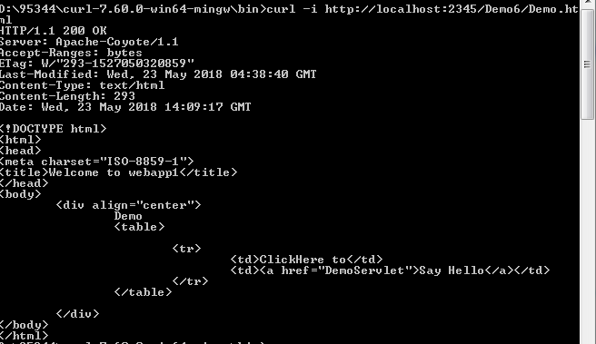
200 Status code

Slide 7


